Slide 1
Recursive Framework for
Type Mappings
Service-Oriented Software Engineering
Software Institute
Nanjing University
Bei Jia

Slide 2
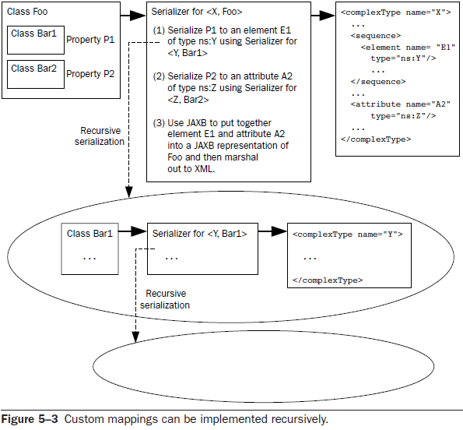
Recursive Framework for Type Mappings
In order to implement <oms:simpleOrder, samples.MySimpleOrder> you had to implement the following mappings implicitly: <oms:billTo, samples.MyAddress>
<oms:item, samples.MyItem>
So it is natural to define type mappings (and their implementations) recursively

Slide 3
Recursive Serializer Interface
Serializer.java
…
public interface Serializer {
public Source getXML(Object o);
}

Slide 4
Recursive Serializer MySimpleOrderSerializer.java (1/2)
…
private SimpleOrder transformMySimpleOrderToJAXB(MySimpleOrder order)
throws JAXBException {
SimpleOrder jaxbSimpleOrder = new SimpleOrder();
// map the addresses
MyAddress myAddress = order.getBillTo();
Serializer myAddressSer = new MyAddressSerializer();
JAXBElement<SimpleOrder.BillTo> jaxbBillToElt =
(JAXBElement<SimpleOrder.BillTo>) jaxbUnmarshaller.unmarshal(
myAddressSer.getXML(myAddress), SimpleOrder.BillTo.class);
jaxbSimpleOrder.setBillTo(jaxbBillToElt.getValue());
…

Slide 5
Recursive Serializer MySimpleOrderSerializer.java (2/2)
…
// map the items
Serializer myItemSer = new MyItemSerializer();
jaxbSimpleOrder.setItems(new SimpleOrder.Items()); // needed to avoid NPE
List<ItemType> jaxbItemList = jaxbSimpleOrder.getItems().getItem();
for (MyItem myItem : order.getItemList()) {
JAXBElement<ItemType> jaxbItemTypeElt =
(JAXBElement<ItemType>) jaxbUnmarshaller.unmarshal(
myItemSer.getXML(myItem), ItemType.class);
jaxbItemList.add(jaxbItemTypeElt.getValue());
}
return jaxbSimpleOrder;
}
…

Slide 6
Recursive Serializer MyAddressSerializer.java (1/2)
…
public Source getXML(Object o) {
SimpleOrder.BillTo jaxbBillTo;
try {
jaxbBillTo = transformMyAddressToBillTo((MyAddress) o);
JAXBElement<SimpleOrder.BillTo> jaxbBillToElt =
new JAXBElement<SimpleOrder.BillTo>(
new QName("http://www.example.com/oms", "billTo"),
SimpleOrder.BillTo.class,
SimpleOrder.class,
jaxbBillTo);
ByteArrayOutputStream ba = new ByteArrayOutputStream();
m.marshal(jaxbBillToElt, ba);
return new StreamSource(new StringReader(ba.toString()));
} catch (JAXBException e) {
throw new RuntimeException(e);
}
}
…

Slide 7
Recursive Serializer MyAddressSerializer.java (2/2)
…
private SimpleOrder.BillTo transformMyAddressToBillTo(MyAddress myAddr)
throws JAXBException {
SimpleOrder.BillTo jaxbBillTo = new SimpleOrder.BillTo();
jaxbBillTo.setName(myAddr.name);
jaxbBillTo.setCity(myAddr.city);
jaxbBillTo.setPhone(myAddr.phone);
jaxbBillTo.setState(myAddr.state);
jaxbBillTo.setStreet(myAddr.street);
jaxbBillTo.setZip(myAddr.zip);
return jaxbBillTo;
}
…

Slide 8
Recursive Serializer
MyItemSerializer.java
…
public Source getXML(Object o) {
MyItem myItem = (MyItem) o;
String xml =
"<?xml version=\"1.0\" encoding=\"UTF-8\"?>" +
"<item xmlns=\"http://www.example.com/oms\" productName=\"" +
myItem.getProductName() + "\">" +
"<quantity>" + myItem.getQuantity() + "</quantity>" +
"<price>" + myItem.getPrice() + "</price>" +
"</item>";
return new StreamSource(new StringReader(xml));
}
…

